Slide 1
Node.js

Slide 2
What is node.js
An open-source cross platform runtime environment for server-side and networking applications
An asynchronous event-driven framework using callbacks
Uses a non-blocking I/O model to be lightweight and efficient
Applications for node are written in JavaScript
Built on top of Chrome's JavaScript runtime, the V8 engine
Lightweight and Scalable
Write your front-end and back-end in the same language
Started in 2009 but not really supported and split in github
Merger happened in 2015 and moved to V4
Currently a version 6 in development
Notes:
History – Joyent 2009. Support was difficult
Open source so you could have forks – one branch was io.js – it had better support than node.
People were using node and the paths were diverging io.js actually got to v3 and node is still not at 1.0
Less than a month ago they announced a merge and the Node Foundation formation
Now node.js 4 is out and is the happy marriage of the two (finally)

Slide 3
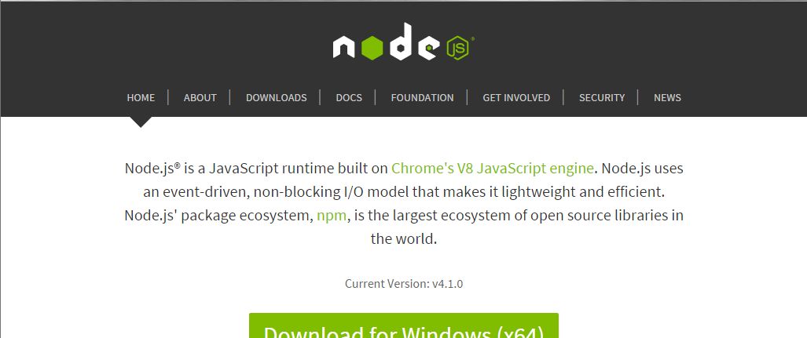
Running node
Download from nodejs.org – download LTS version
Multiple ways to run
Console – enter commands directly
Command line – read in files, install modules/packages, etc

Slide 4
New paradigm
Event-driven, non-blocking programming model
Can be somewhat confusing to start
Need to really understand how web servers work
Centred around applications that do lots of different things with lots of different things
Developing applications and web servers to process requests from the user/browser or other input

Slide 5
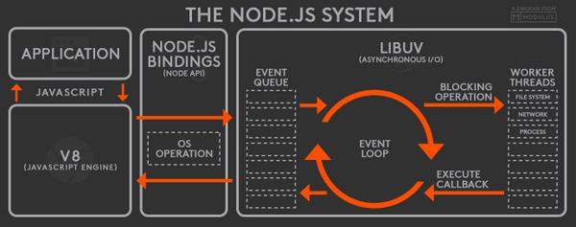
Node js Execution
Uses a single-threaded event loop

Slide 6
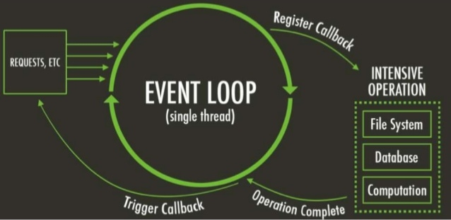
The Event Loop
Node js is event driven – sits and waits
Event loop controls how things are sent to and received from node.js operations

Slide 7
Non-blocking
Blocking is when the execution of an application must wait until another operation completes
The operation that must complete is said to be blocking the execution
In node, all methods that are “CPU intensive” (like I/O) have two versions – blocking and unblocking
Blocking methods are synchronous
Non-blocking are asynchronous
Non-blocking methods use a callback function which will be executed once the method completes

Slide 8
Blocking
const fs = require(‘fs’); var data = fs.readsync(‘/file.txt’); //do something after data read
Non-Blocking
const fs = require(‘fs’); fs.readFile(‘file.txt’, (err, data) => { if (err) throw err; }); //do something immediately
Notes:
Point out in second example that cannot do something immediately with the data

Slide 9
Asynchronous Tasks
Asynchronous tasks continue while waiting for a task to complete
Use callback functions to know when a task is complete
Just like function when AJAX returns with readystate changes
Callbacks
A place to go when things are complete
Notes:
Show example01a and 01b and explain the differences
Change 01b to be a function instead of an anonymous function

Slide 10
Making Asynchronous Work
Check and validate parameters
Tell node.js to queue up a call to a function and notify (call) the callback function when there is a result
Return to the caller
Node operates with event queue
If there are pending events waiting for a response it will not exit
Waits until code finishes AND there are no more events in queue
Notes:
Show example02a and 02b

Slide 11
Error Handling
All callback functions have at least one parameter
The success or failure of the last operation
Usually also a second parameter
The data from the previous operation
doSomething(p1,p2,p3,…,pN, function(err, results) {...}
err parameter
null if operation was a success
An instance of the Error object class
Notes:
Show 2b and add code for error handling; change filename to show that it works.

Slide 12
Giving Up Control
Node runs in a single thread with a single event loop
Loop makes calls to external functions and services to do the work
Callback functions are in the event queue to wait for responses

Slide 13
Modules
Node architecture is based around small modules with plenty of re-use
Many that come with node and many more that can be downloaded and added
Can easily write your own
Remember the idea is to make things small
To use a module, must ‘require‘ it
This links the module with the current node js program
Notes:
Do demo first of Example03 with module a
Then do module b with functions. Show with first and why it doesn’t work. Then add brackets and it will.

Slide 14
Modules
Modules expose functions (API) through exports
Can export individual pieces using exports
Can export entire module using module.exports (more like a class or object)
Try to adhere to asynchronous nature of node
Use process.nextTick to be non-blocking
Notes:
Show example 4

Slide 15
process.nextTick
Turns synchronous call asynchronous
Puts the function on the event queue for the next time the event loop comes around and the function is complete
ALWAYS pass the result as the second parameter of the callback function
First parameter is reserved for errors
Notes:
Show example4b – note that throwing error okay in simple example but would not want to do this in real example.

